Slide 1
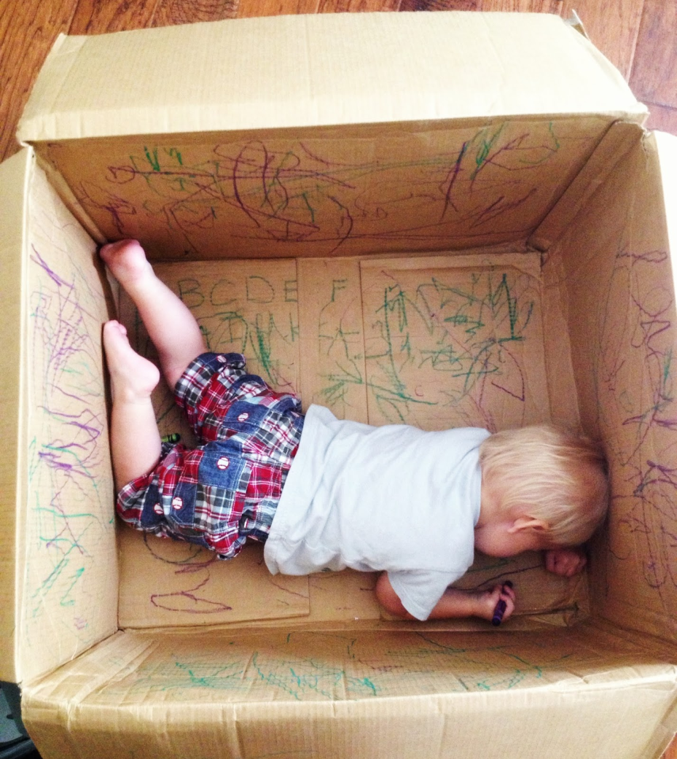
Thinking inside the Box
Bringing Back Touch and Feel to Structures Design Instruction
Luis Gonzalez

Slide 2
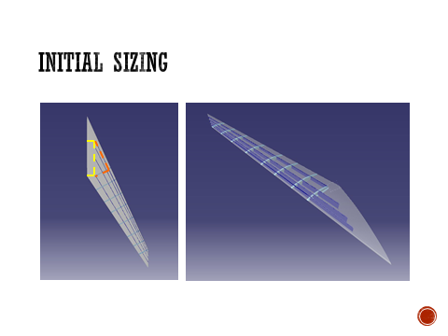
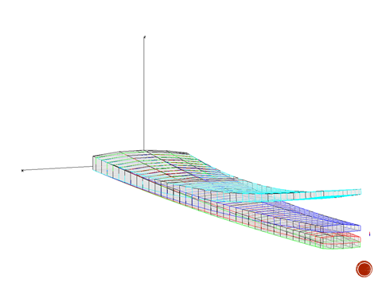
Capstone Design Project

Slide 3
Structure Analysis

Slide 4
Project and mini-project

Slide 5
Statement of Work
Design a wingbox with the following Outer Mold Line (OML) dimensions (all in cm)
Weight not to exceed of 8 kg
112
5
14

Slide 6
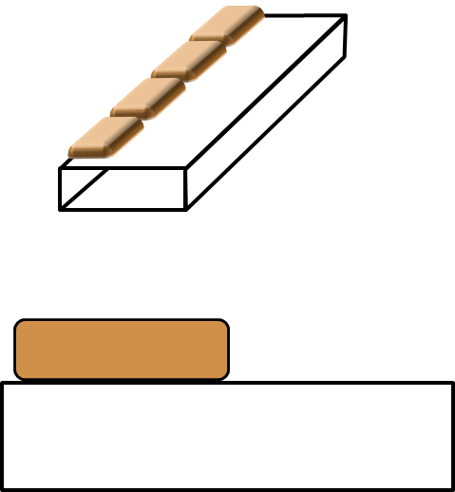
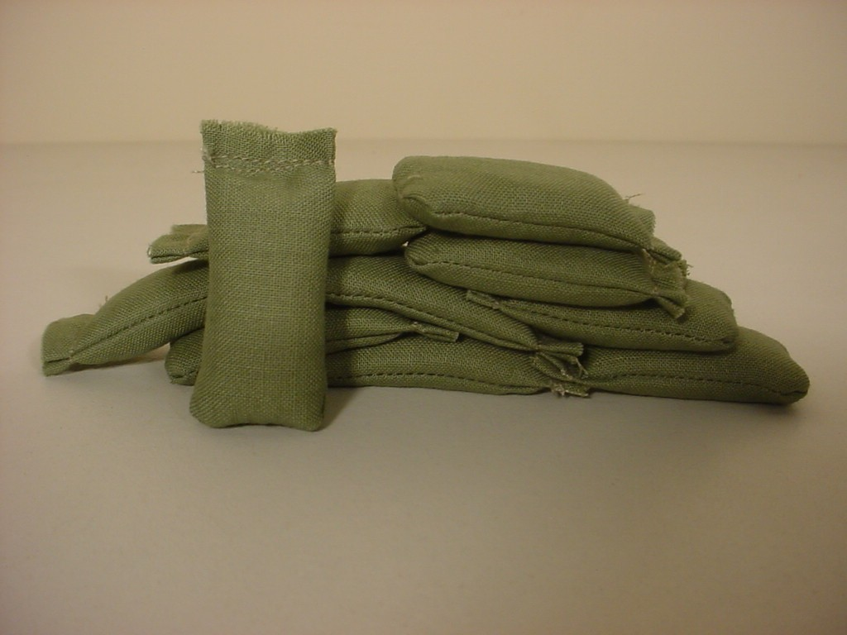
Loads
Sand bags of (7 × 18 cm) of 500 g all along the span, on the front half of chord

Slide 7
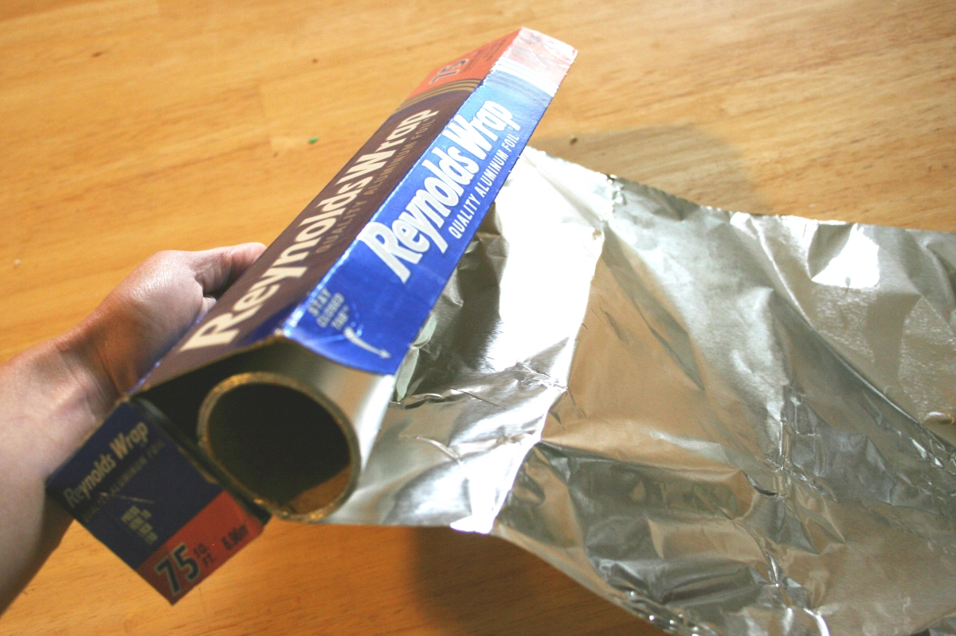
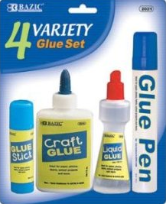
Materials

Slide 8
Conceptual Design

Slide 9
Design and Manufacture

Slide 10
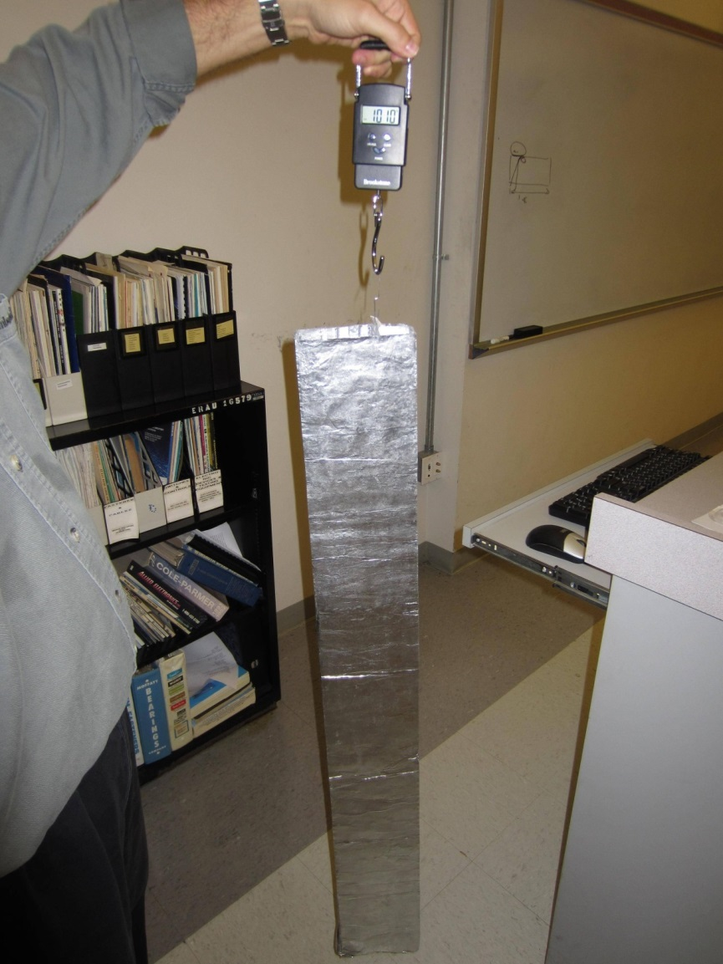
Weight constraint

Slide 11
Test

Slide 12
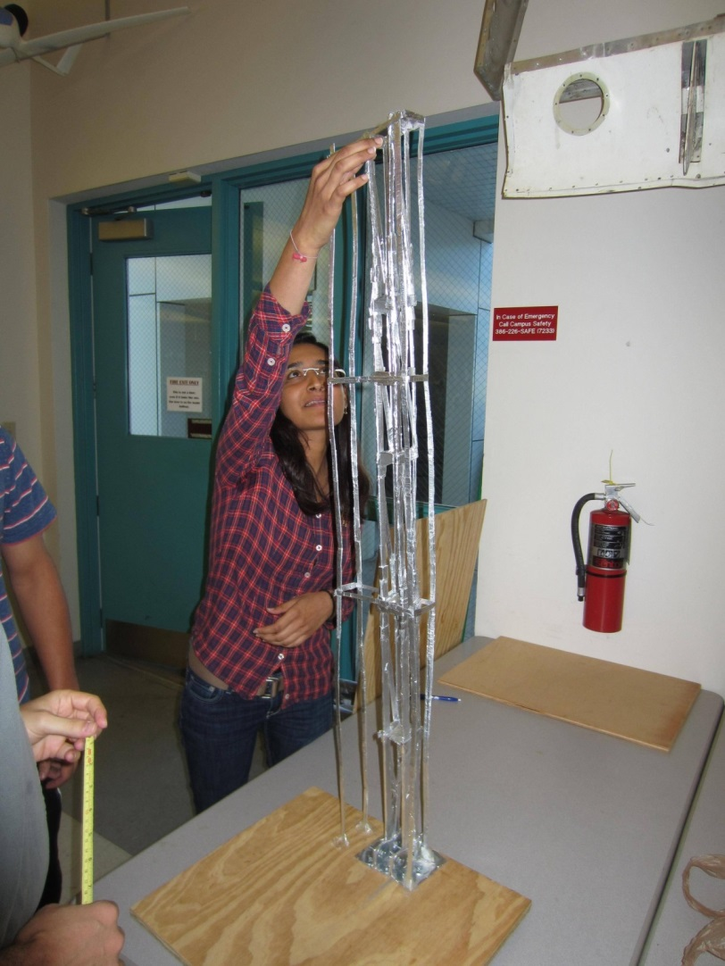
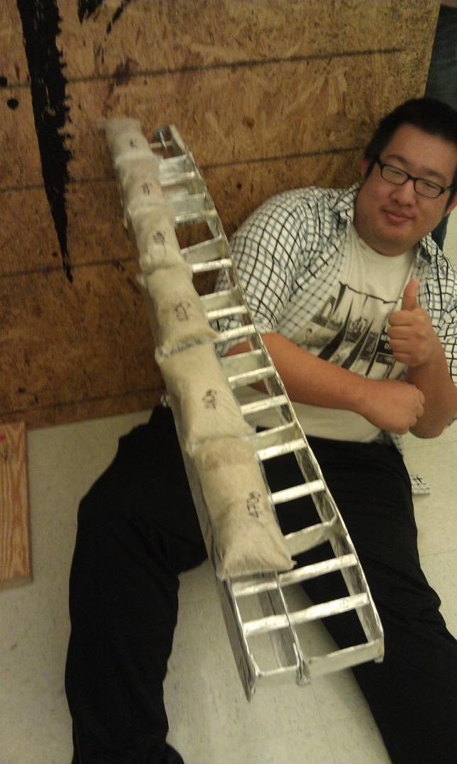
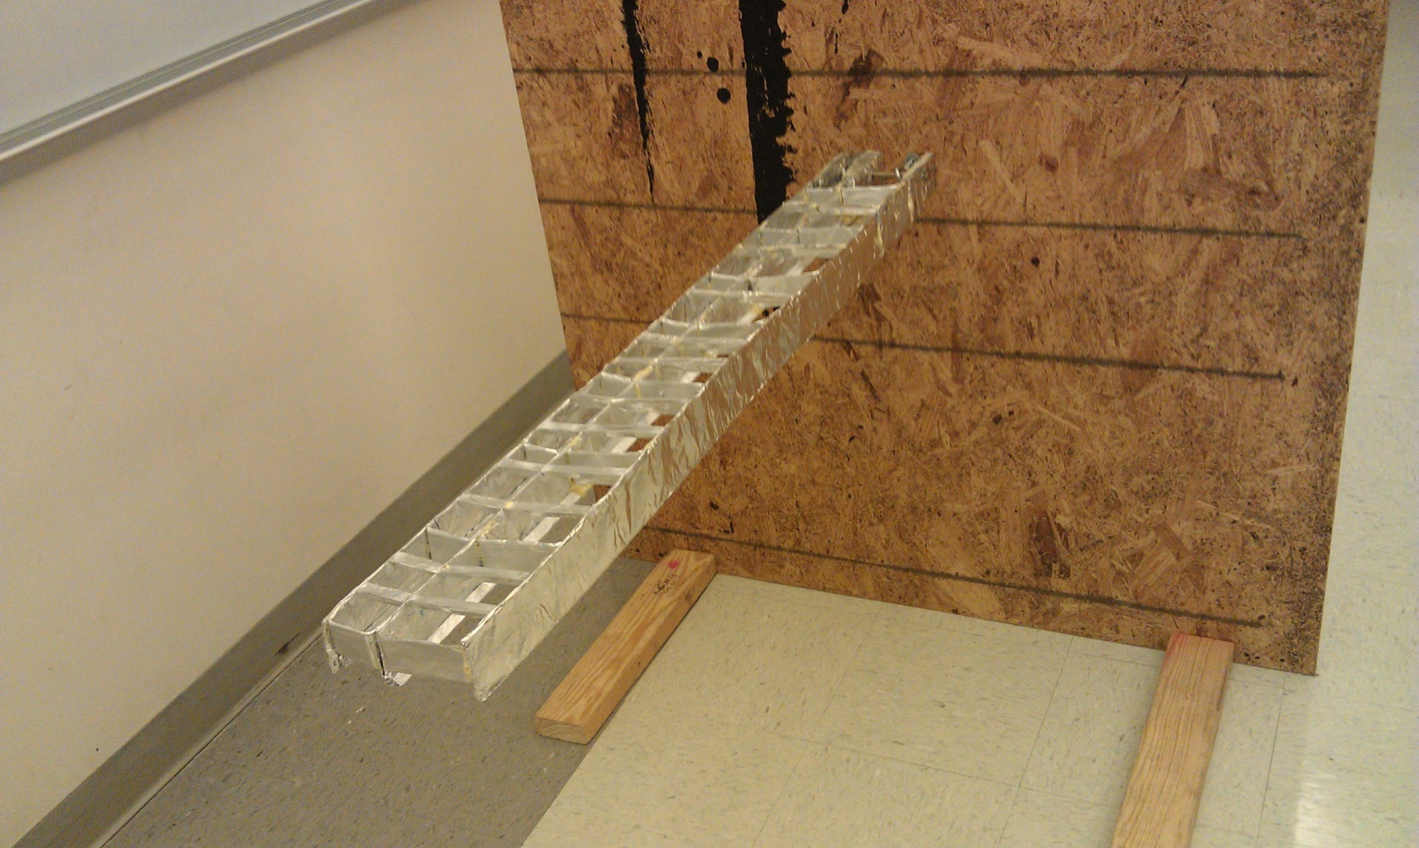
Creative Solutions

Slide 13
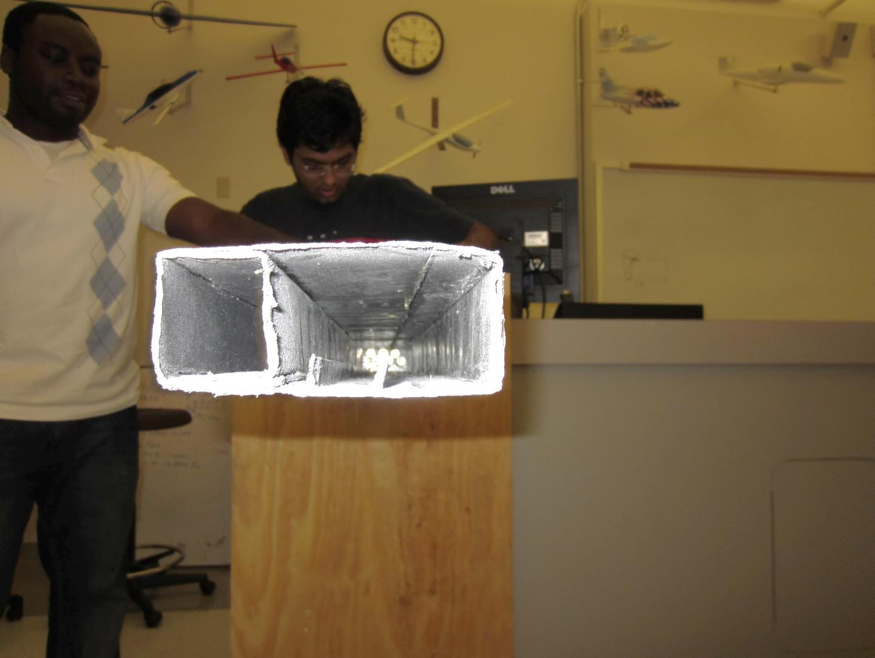
Creative Solutions

Slide 14
Root joint

Slide 15
Results
TEAM | CONCEPT/ CONSTRUCTION | DIMENSIONS (cm) | WEIGHT (g) | TEST (PASS/FAIL)
1 | Monolithic | 4.5 × 14 × 116 | 1610 | P
2 | Multispar/ribs | 6 × 14±1 × 113 | 1390 | P
3 | Honeycomb | 5.5~6 × 14 × 112.8 | 1230 | P
4 | Multicell | 4~5 × 13 × 113.5 | 1980 | P
5 | I-beam/honeycomb | 4~4.8 × 13.5~14 × 112 | 650 | F

